Slide 1
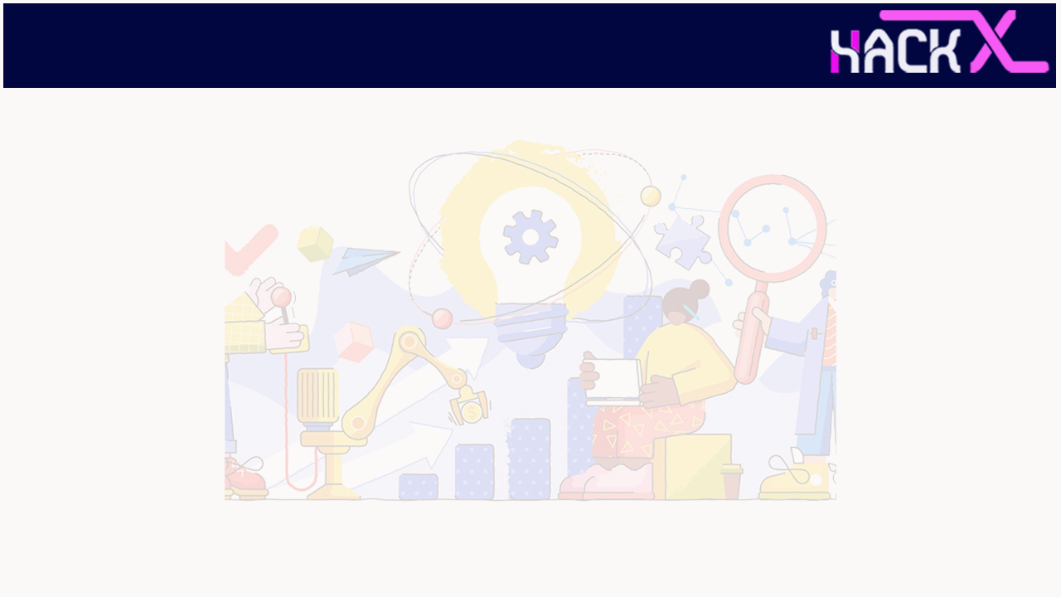
SLIDE 1
Team Name: iTechians
2. Sriniketh J – 6385685916 (Leader)
Viswa Kumar N – 9345705210
3. Domain Name: IoT
4. IoT Home application using GSM-based cellular

Slide 2
SLIDE 2
ABSTRACT
To overcome the problems stated we have developed a security system which can be integrated anywhere like home, workplace, shops, etc.
We have developed our security system using ESP-8266 Node MCU as our base.
So to ensure or enhance the security we have interfaced using a few sensors. To name a few like DHT11(thermal sensor), RKI-3100(flame sensor) etc.
With the help of GSM Module alerts in the form of calls or messages can be sent to the owner.
And not only that we have integrated with the cloud server and with the help of which we can control the things like fan, light, buzzer everything in one go.
Another biggest integration is that we have connected with Alexa where we can control the same with the help of voice.
We also have a simple chatbot in the cloud for some help.
This the basic thought process involved in the development the project.

Slide 3
SLIDE 3
NOVELTY
Can control everything using Mobile App
Can control the same in the Web Dashboard
It’s voice controllable as well
Can get the statistics of real time data in the form of CSV’s which can be used for ML models.
Can monitor all the real time data
Chatbot integrated for support
Cloud makes it easy to store lots of data without storage troubles

Slide 4
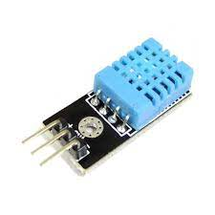
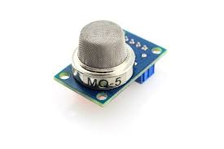
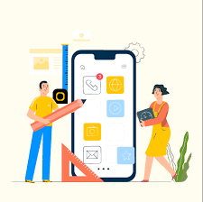
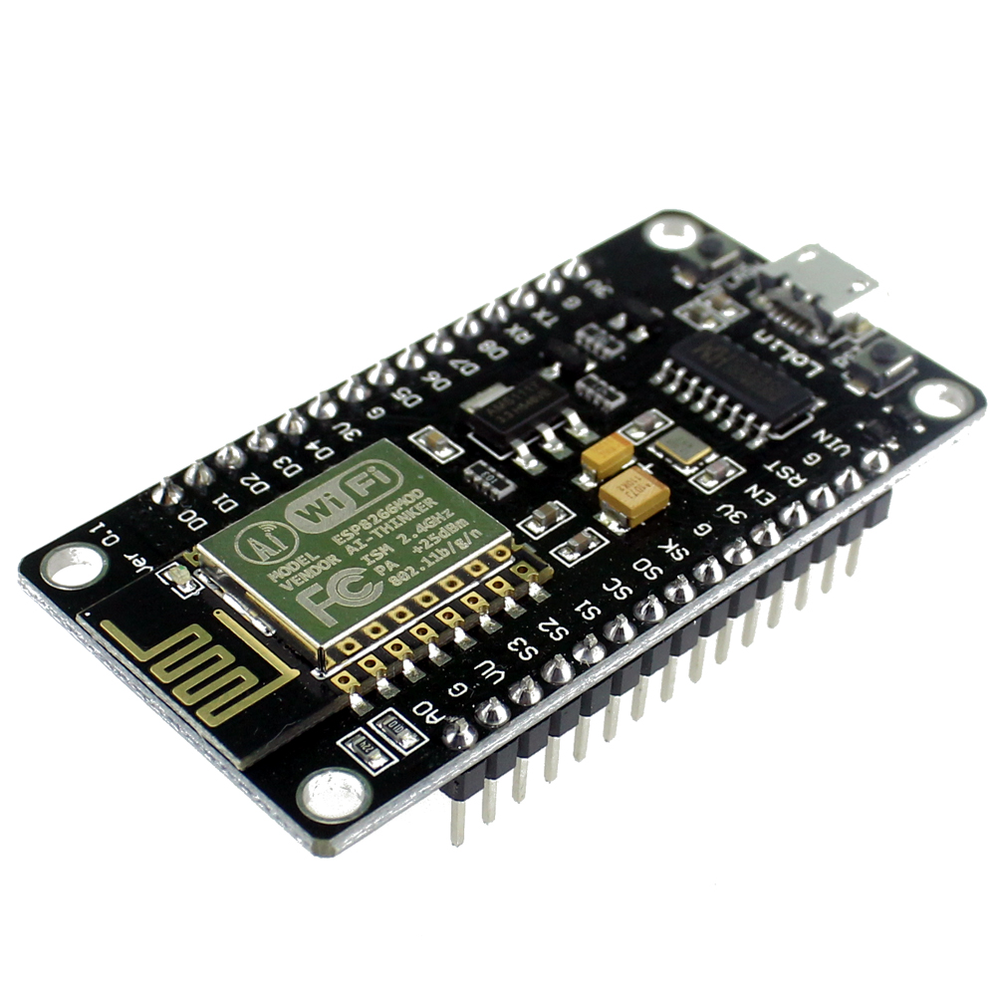
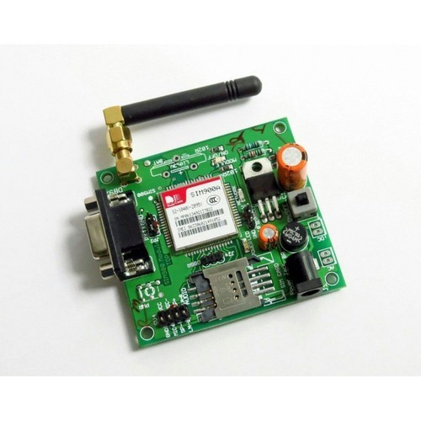
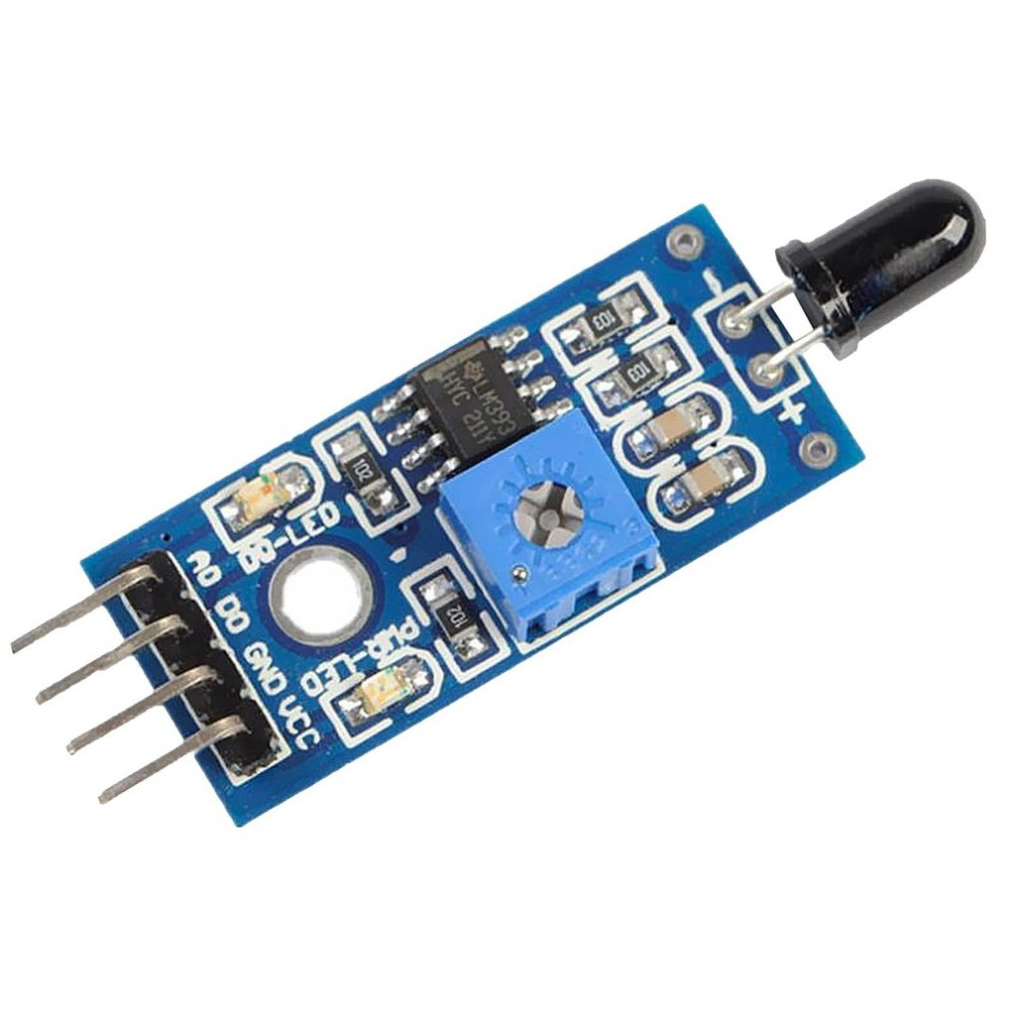
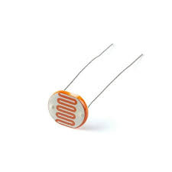
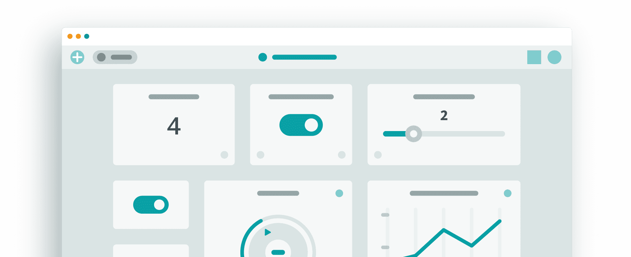
TECHNOLOGY
STACK
SLIDE 4
ESP 8266-Node MCU
GSM Module
Mobile App/
Web Dashboard
SENSORS

Slide 5
HARDWARE / SOFTWARE IMPLEMENTATION
SLIDE 5
Hardware
ESP 8266-Node MCU
DHT11 – Thermal Sensor
Photoresistor
RKI-3100
MQ5 - Gas Sensor
LED’s
Buzzer
DC Motor
Software
Arduino IoT Cloud
IoT Remote Mobile App
Alexa (software)

Slide 6
BUSINESS SCOPE
SLIDE 6
It can save lots of money in the form of relief as rather than connecting only appliances we have tried to integrate the sensors like water sensors in restrooms, fire sensors in the kitchen, temperature sensor in the (hall) lobby, etc.
Voice controllable so that everyone including a blind person can use it.
Chatbots are additional plus point as all tech companies use it and sort many problems.
Dashboard and Mobile App is authenticated and can be accessed by owner and permission given by the owner to others.
Since we can store the data we can alert the owner to replace any faulty appliances or sensor if the data is not in particular range.
We can use that data to develop Machine Learning models after complete pre-processing to predict the future and alert prior than the owner realizes it.

